Slide 1
Birds Classification using Scikit-learn
Presented by:
Suraiya Mahmuda(364)
Md. Rakibul Haque(373)
Farhan Ahmed Onu(405)

Slide 2
Outlines
Project Overview
Objectives
Required Tools
Dataset Description
Preprocessing
Feature Extraction
Model Training
Results & Performance
Visual Outputs
Confusion Matrix
Conclusion

Slide 3
Project Overview
Developing a traditional ML pipeline for Birds Image Classification.
Uses HOG feature extraction and SVM for classification.

Slide 4
Objectives
Classify Bird images using a traditional ML approach
Explore the effectiveness of HOG and SVM
Demonstrate performance on a small-scale dataset

Slide 5
Required Tools
Programming Language: Python
Libraries: Scikit-learn, Scikit-image, Joblib
Techniques: HOG (Histogram of Oriented Gradients), SVM (Support Vector Machine)

Slide 6
Dataset Used
Dataset consisting around 700 Samples Birds of Jahangirnagar University
Total six classes: Dahuk, Doel, Heron__Bok, Kokil, Machranga, Pecha
Images resized to 150x150, converted to grayscale

Slide 7
Data Preprocessing
Resized all images to 150x150 pixels
Converted to grayscale for feature extraction
Stored as NumPy arrays
Used joblib for data serialization

Slide 8
Feature Extraction
Used HOG to extract edge and texture-based features
Captured shapes and contours of birds
Implemented using scikit-image

Slide 9
Model Training
Classifier: Support Vector Machine (SVM)
Data Split: 80% Training, 20% Testing
Balanced class distribution using shuffling

Slide 10
Performance
Accuracy Achieved: ~69%
Used confusion matrix to evaluate predictions
Improvement possible with more data

Slide 11
Project Code Overview
Data Loading & Splitting
Preprocessing
Convert RGB images to grayscale
Extract HOG features for edge and shape representation

Slide 12
Project Code Overview(Cont.)
Model Training
Integrate these steps into a scikit‑learn pipeline with a classifier (e.g., SGDClassifier or SVC).
Hyperparameter Tuning
Use GridSearchCV to optimize HOG parameters and classifier settings via cross‑validation.
Evaluation & Deployment
Save the model and predict for new images

Slide 13
To run this Project
Follow this sequence:
prepare_dataset.py
train_model.py
grid_search.py

Slide 14
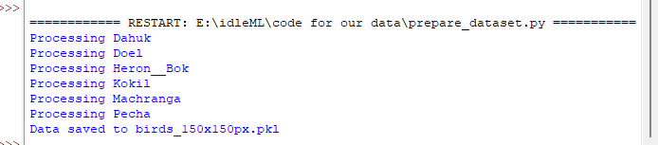
Preparing Dataset

Slide 15
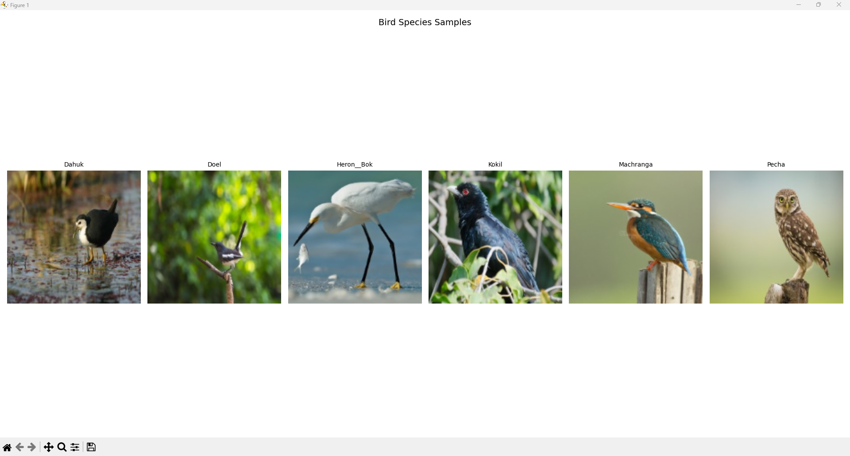
Bird Species Samples

Slide 16
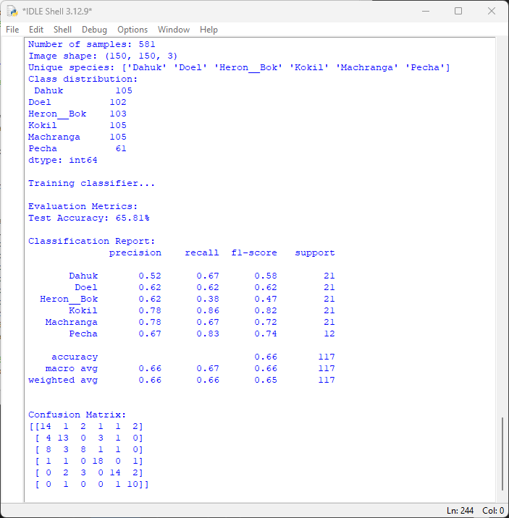
Classification Report

Slide 17
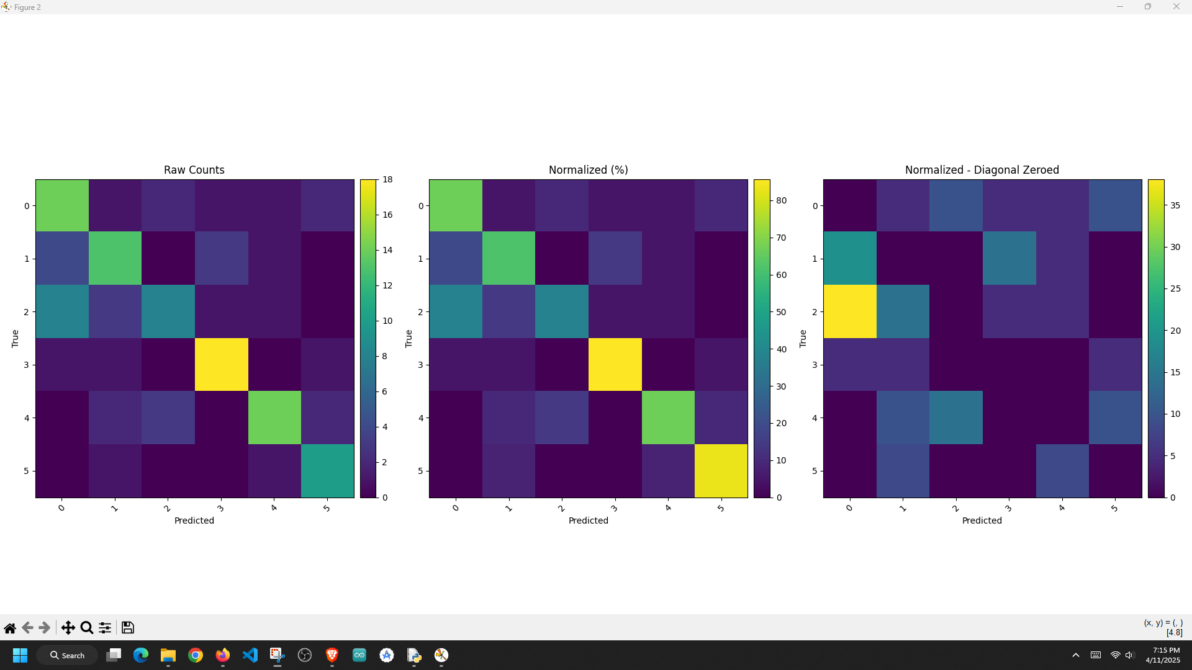
Confusion Matrix

Slide 18
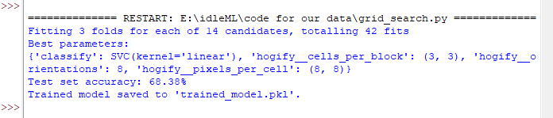
After Running Grid Search

Slide 19
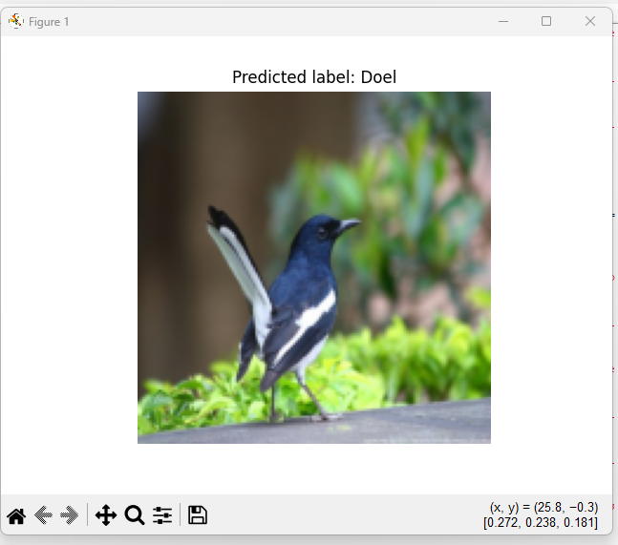
Prediction from Model

Slide 20
Conclusion
Built a traditional ML pipeline for image classification
HOG + SVM demonstrated reasonable accuracy (~69%)
Approach is effective for small datasets
Potential for enhancement with more data or deep learning

Slide 21


Slide 22


